Slide 1
INFORMED (HEURISTIC) SEARCH STRATEGIES
Course Code: CSC4226
Course Title: Artificial Intelligence and Expert System
Dept. of Computer Science
Faculty of Science and Technology
Lecture No: | Four (4) | Week No: | Four (4) | Semester:
Lecturer: | Dr. Ashraf Uddin dr.ashraf@aiub.edu

Slide 2
LECTURE OUTLINE
BEST-FIRST SEARCH
GREEDY BEST-FIRST SEARCH
A* SEARCH
CONDITIONS FOR OPTIMALITY
OPTIMALITY OF A*

Slide 3
INFORMED SEARCH STRATEGY
Informed search strategy—
one that uses problem-specific knowledge beyond the definition of the problem itself
can find solutions more efficiently than can an uninformed strategy.
problem-specific knowledge is the extra bit of information the program uses rather than the problem formulation, thus known as Informed Search

Slide 4
BEST-FIRST SEARCH
The general approach to informed search is called best-first search
Best-first search is an instance of the general TREE-SEARCH or GRAPH-SEARCH algorithm in which a node is selected for expansion based on an evaluation function, f(n).
The evaluation function is construed as a cost estimate, so the node with the lowest evaluation is expanded first
The implementation of best-first graph search is identical to that for uniform-cost search, except for the use of f instead of g to order the priority queue.
The choice of f determines the search strategy.

Slide 5
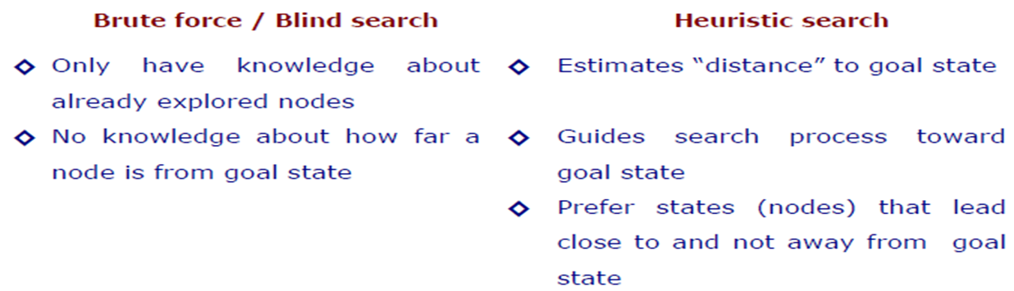
HEURISTIC SEARCH COMPARED WITH BLIND SEARCH

Slide 6
HEURISTIC FUNCTION
The choice of f(evaluation function) determines the search strategy
Best-first algorithms include as a component of f a heuristic function, denoted h(n)
h(n) = estimated cost of the cheapest path from the state at node n to a goal state.
h(n) takes a node as input, but, unlike g(n), it depends only on the state at that node.
Heuristic functions are the most common form in which additional knowledge of the problem is imparted to the search algorithm
Consider them to be arbitrary, nonnegative, problem-specific functions, with one constraint: if n is a goal node, then h(n)=0.

Slide 7
GREEDY BEST-FIRST SEARCH
Greedy best-first search tries to expand the node that is closest to the goal, on the grounds that this is likely to lead to a solution quickly.
Thus, it evaluates nodes by using just the heuristic function; that is, f(n) = h(n).
“greedy”—at each step it tries to get as close to the goal as it can.
Its search cost is minimal. It is not optimal.
Greedy best-first tree search is also incomplete even in a finite state space, much like depth-first search.

Slide 8
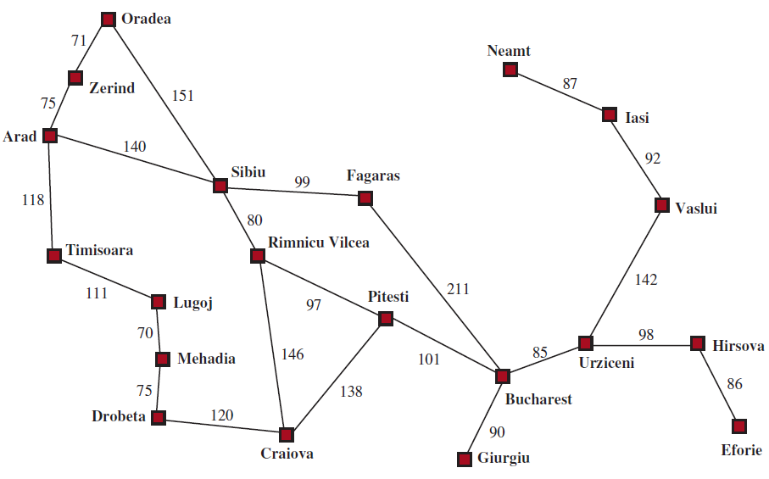
STRAIGHT-LINE DISTANCE HEURISTIC

Slide 9
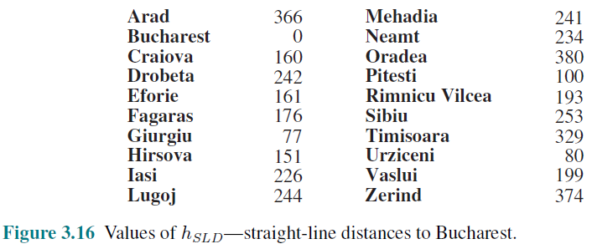
STRAIGHT-LINE DISTANCE HEURISTIC

Slide 10
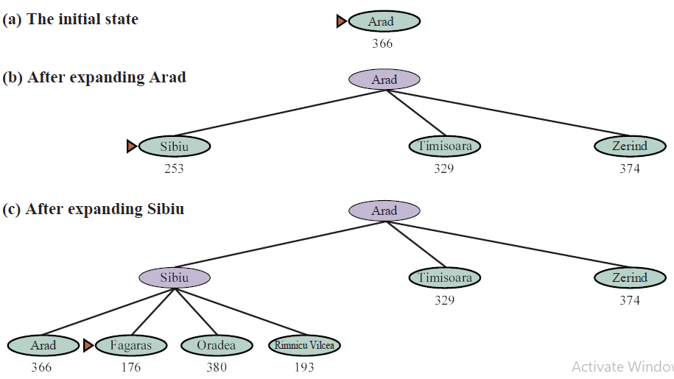
GREEDY BEST-FIRST TREE SEARCH

Slide 11
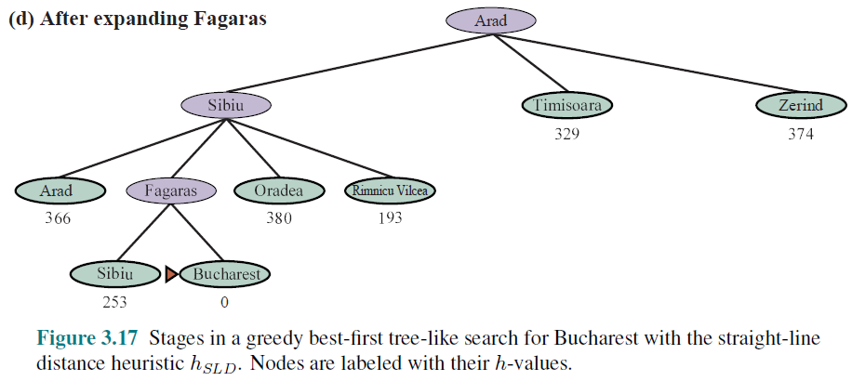
GREEDY BEST-FIRST TREE SEARCH

Slide 12
A* SEARCH: MINIMIZING THE TOTAL ESTIMATED SOLUTION COST
The most widely known form of best-first search is called A*search
It evaluates nodes by combining
g(n), the cost to reach the node, and
h(n), the cost to get from the node to the goal:
f(n) = g(n) + h(n) .
Since
g(n) gives the path cost from the start node to node n, and
h(n) is the estimated cost of the cheapest path from n to the goal,
we have f(n) = estimated cost of the cheapest solution through n .
A∗ search is both complete and optimal.
The algorithm is identical to UNIFORM-COST-SEARCH except that
A∗ uses g + h instead of g.

Slide 13
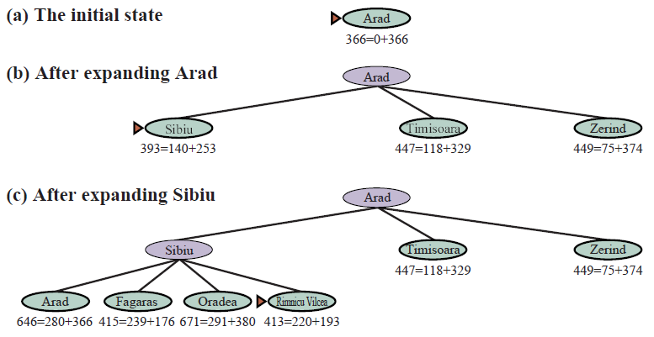
A∗ SEARCH FOR BUCHAREST

Slide 14
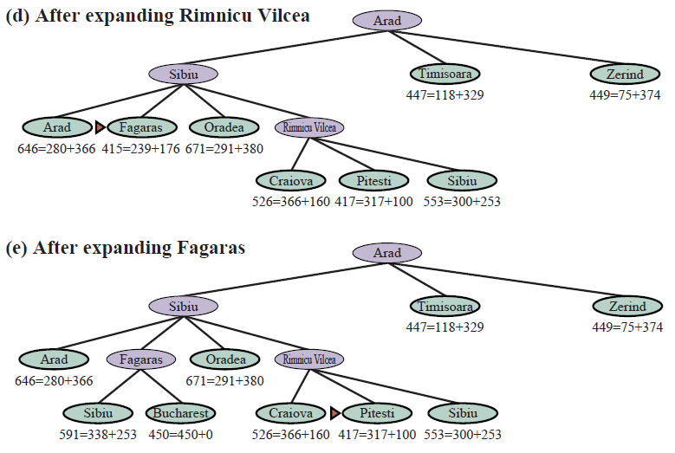
A∗ SEARCH FOR BUCHAREST

Slide 15
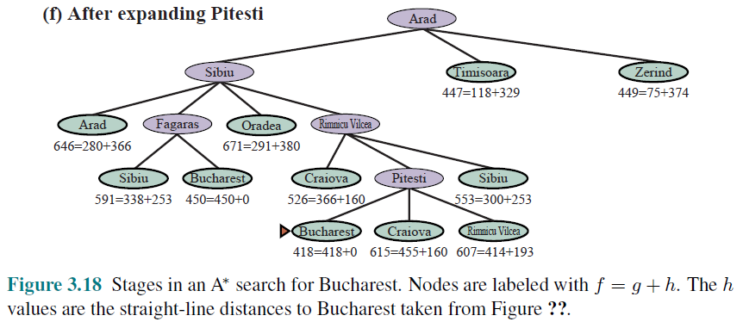
A∗ SEARCH FOR BUCHAREST

Slide 16
CONDITIONS FOR OPTIMALITY: ADMISSIBILITY AND CONSISTENCY
The first condition we require for optimality is that h(n) be an admissible heuristic
An admissible heuristic is one that never overestimates the cost to reach the goal
Because g(n) is the actual cost to reach n along the current path, and f(n)=g(n) + h(n), we have as an immediate consequence that f(n) never overestimates the true cost of a solution along the current path through n.
Admissible heuristics are by nature optimistic because they think the cost of solving the problem is less than it actually is.

Slide 17
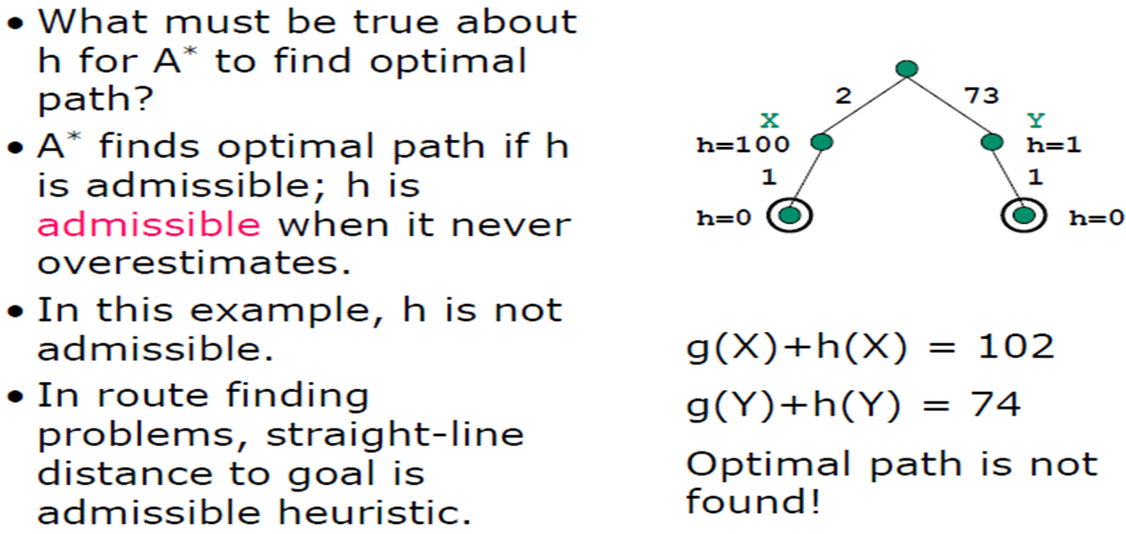
ADMISSIBILITY

Slide 18
CONSISTENCY
A second, slightly stronger condition called consistency (or sometimes monotonicity) is required only for applications of A∗ to graph search.
A heuristic h(n) is consistent if, for every node n and every successor n’ of n generated by any action a, the estimated cost of reaching the goal from n is no greater than the step cost of getting to n’ plus the estimated cost of reaching the goal from n’ :
h(n) ≤ c(n, a, n’) + h(n’).
This is a form of the general triangle inequality, which stipulates that each side of a triangle cannot be longer than the sum of the other two sides

Slide 19
OPTIMALITY OF A*
A∗ has the following properties: the tree-search version of A∗ is optimal if h(n) is admissible, while the graph-search version is optimal if h(n) is consistent.
if h(n) is consistent, then the values of f(n) along any path are nondecreasing.
The proof follows directly from the definition of consistency. Suppose n is a successor of n; then g(n’)=g(n) + c(n, a, n’) for some action a, and we have
f(n’) = g(n’) + h(n’)
f(n’) = g(n) + c(n, a, n’) + h(n’) because g(n’) = g(n) + c(n, a, n’)
f(n’) ≥ g(n) + h(n) because c(n, a, n’) + h(n’) >= h(n)
f(n’) = f(n)
So, f(n’) >= f(n)

Slide 20
OPTIMALITY OF A*
The next step is to prove that whenever A∗ selects a node n for expansion, the optimal path to that node has been found. Were this not the case, there would have to be another frontier node n’ on the optimal path from the start node to n; because f is nondecreasing along any path, n’ would have lower f-cost than n and would have been selected first.

Slide 21
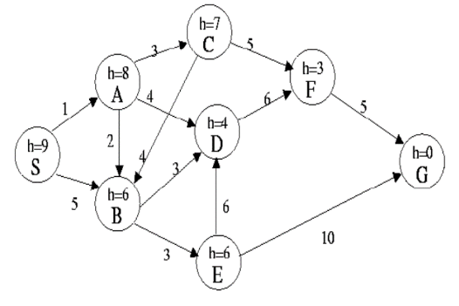
Example (Simulation)
Consider S is the starting state, and G is the goal state in the graph. The heuristic value h(n) is given in square boxes and the step costs are given in the edges.
Construct the search tree to find the least cost path from the start state S to the goal state G using GBFS and A* search for the given graph.
Clearly mention the expand sequence and, path with the path cost.

Slide 22

Example (GBFS)
Expanded Node List
Empty
Priority Queue
S (9)
Greedy Best-First Search (GBFS) also uses a priority queue, but the priority value is based on a heuristic function h(n), which estimates the cost from the current node n to the goal node.
The heuristic values are additional information provided beyond the problem definition to guide the search. GBFS selects the path that appears closest to the goal based on the heuristic value, without considering the actual cost from the start node.

Slide 23
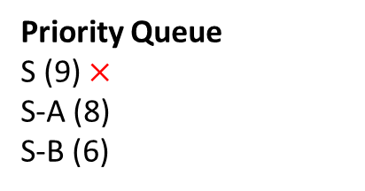
Example (GBFS)
Expanded Node List
S
S,9
Priority Queue
S (9) $×$
S-A (8)
S-B (6)
A,8
B,6
Unlike UCS, Greedy Best-First Search (GBFS) uses only the heuristic value as the priority value, ignoring the actual path cost from the start node.
For example, in the case of the path S-A, the actual path cost is 1, but the heuristic value for node A is used as the priority value. Similarly, for the path S-B, the priority value is set to 6 based on the heuristic for B.
Since GBFS selects the path with the lowest heuristic value, the path S-B will be selected next.

Slide 24
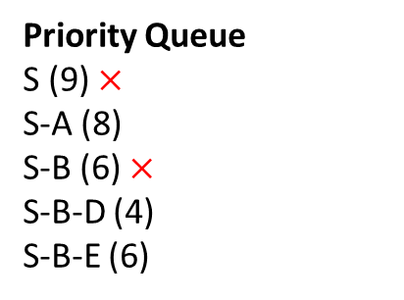
Example (GBFS)
Expanded Node List
S, B
S,9
Priority Queue
S (9) $×$
S-A (8)
S-B (6) $×$
S-B-D (4)
S-B-E (6)
A,8
B,6
D,4
E,6
After expanding the path S-B, the queue contains three paths: S-A, S-B-D, and S-B-E.
In Greedy Best-First Search (GBFS), the path with the lowest heuristic value is selected next. Therefore, the path S-B-D will be selected for expansion as it has the lowest heuristic value among the three.

Slide 25
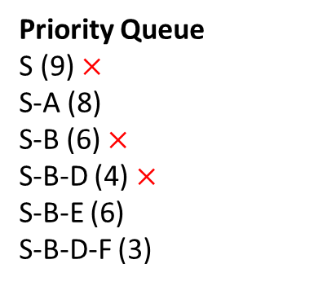
Example (GBFS)
Expanded Node List
S, B, D
S,9
Priority Queue
S (9) $×$
S-A (8)
S-B (6) $×$
S-B-D (4) $×$
S-B-E (6)
S-B-D-F (3)
A,8
B,6
D,4
E,6
F,3

Slide 26
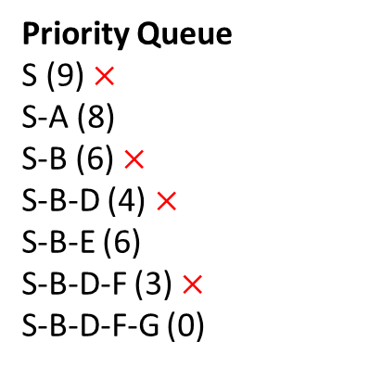
Example (GBFS)
Expanded Node List
S, B, D, F
S,9
Priority Queue
S (9) $×$
S-A (8)
S-B (6) $×$
S-B-D (4) $×$
S-B-E (6)
S-B-D-F (3) $×$
S-B-D-F-G (0)
A,8
B,6
D,4
E,6
F,3
G,0

Slide 27

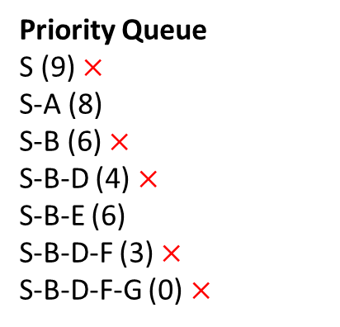
Example (GBFS)
Expanded Node List
S, B, D, F
S,9
Priority Queue
S (9) $×$
S-A (8)
S-B (6) $×$
S-B-D (4) $×$
S-B-E (6)
S-B-D-F (3) $×$
S-B-D-F-G (0) $×$
A,8
B,6
D,4
E,6
F,3
G,0
The node G is selected and the goal test is satisfied.

Slide 28
Example (A*)
Expanded Node List
Empty
Priority Queue
S (0+9=9)
A* also uses a priority queue, but unlike GBFS, the priority value is based on both the actual path cost from the start node to the current node and the heuristic function h(n), which estimates the cost from the current node n to the goal node.
In other words, the priority value is the sum of the path cost and the heuristic value: f(n) = g(n) + h(n)
Where: g(n) is the actual path cost from the start node to node n, h(n) is the heuristic estimate of the cost from node n to the goal.
This combination helps A* to both minimize the cost from the start and guide the search towards the goal efficiently.

Slide 29
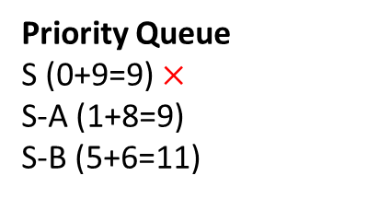
Example (A*)
Expanded Node List
S
S,9
Priority Queue
S (0+9=9) $×$
S-A (1+8=9)
S-B (5+6=11)
A,9
B,11
For the path S-A, the total cost is calculated by adding the path cost from the starting node S to node A (which is 1) and the heuristic value of A (which is 8). Thus, the total cost for S-A is 1 + 8 = 9.
For the path S-B, the total cost is the path cost from S to B (which is 5) plus the heuristic value of B (which is 6). So, the total cost for S-B is 5 + 6 = 11.
Since A* selects the path with the lowest total cost f(n) = g(n) + h(n), the path S-A, with a total cost of 9, will be selected next.

Slide 30
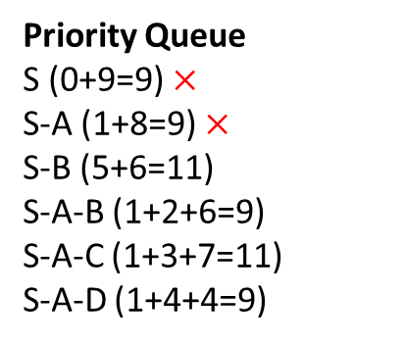
Example (A*)
Expanded Node List
S, A
S,9
Priority Queue
S (0+9=9) $×$
S-A (1+8=9) $×$
S-B (5+6=11)
S-A-B (1+2+6=9)
S-A-C (1+3+7=11)
S-A-D (1+4+4=9)
A,9
B,11
B,9
C,11
D,9

Slide 31
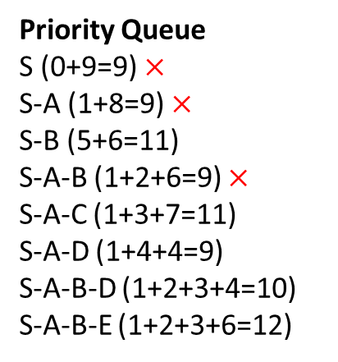
Example (A*)
Expanded Node List
S, A, B
S,9
Priority Queue
S (0+9=9) $×$
S-A (1+8=9) $×$
S-B (5+6=11)
S-A-B (1+2+6=9) $×$
S-A-C (1+3+7=11)
S-A-D (1+4+4=9)
S-A-B-D (1+2+3+4=10)
S-A-B-E (1+2+3+6=12)
A,9
B,11
B,9
C,11
D,9
D,10
E,12

Slide 32
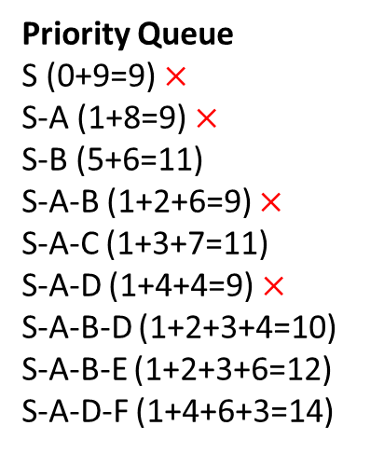
Example (A*)
Expanded Node List
S, A, B, D
S,9
Priority Queue
S (0+9=9) $×$
S-A (1+8=9) $×$
S-B (5+6=11)
S-A-B (1+2+6=9) $×$
S-A-C (1+3+7=11)
S-A-D (1+4+4=9) $×$
S-A-B-D (1+2+3+4=10)
S-A-B-E (1+2+3+6=12)
S-A-D-F (1+4+6+3=14)
A,9
B,11
B,9
C,11
D,9
D,10
E,12
F,14

Slide 33
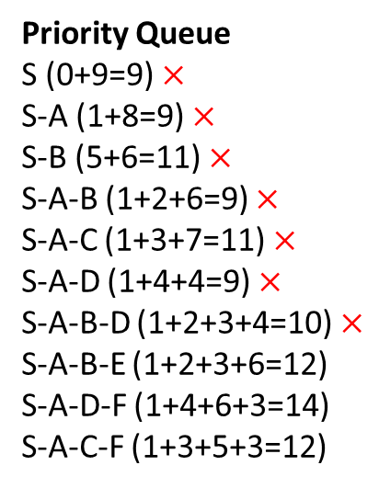
Example (A*)
Expanded Node List
S, A, B, D, C
S,9
Priority Queue
S (0+9=9) $×$
S-A (1+8=9) $×$
S-B (5+6=11) $×$
S-A-B (1+2+6=9) $×$
S-A-C (1+3+7=11) $×$
S-A-D (1+4+4=9) $×$
S-A-B-D (1+2+3+4=10) $×$
S-A-B-E (1+2+3+6=12)
S-A-D-F (1+4+6+3=14)
S-A-C-F (1+3+5+3=12)
A,9
B,11
B,9
C,11
D,9
D,10
E,12
F,14
F,12
The path S-A-B-D was selected but not expanded because it had already been expanded previously, and in A*, once a node is expanded, it is not re-expanded. Similarly, S-B was selected but not expanded.
After that, the path S-A-C was selected and expanded. This continues the search, focusing on the next node with the lowest combined path cost and heuristic value.

Slide 34
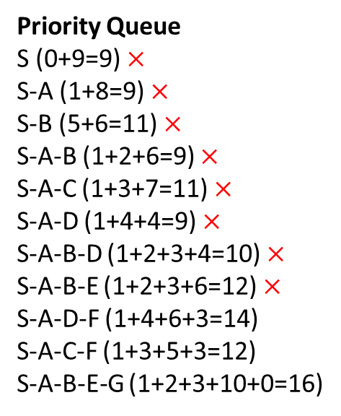
Example (A*)
Expanded Node List
S, A, B, D, C, E
S,9
Priority Queue
S (0+9=9) $×$
S-A (1+8=9) $×$
S-B (5+6=11) $×$
S-A-B (1+2+6=9) $×$
S-A-C (1+3+7=11) $×$
S-A-D (1+4+4=9) $×$
S-A-B-D (1+2+3+4=10) $×$
S-A-B-E (1+2+3+6=12) $×$
S-A-D-F (1+4+6+3=14)
S-A-C-F (1+3+5+3=12)
S-A-B-E-G (1+2+3+10+0=16)
A,9
B,11
B,9
C,11
D,9
D,10
E,12
F,14
F,12
G,16

Slide 35
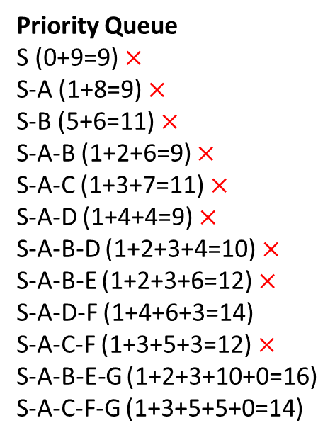
Example (A*)
Expanded Node List
S, A, B, D, C, E, F
S,9
Priority Queue
S (0+9=9) $×$
S-A (1+8=9) $×$
S-B (5+6=11) $×$
S-A-B (1+2+6=9) $×$
S-A-C (1+3+7=11) $×$
S-A-D (1+4+4=9) $×$
S-A-B-D (1+2+3+4=10) $×$
S-A-B-E (1+2+3+6=12) $×$
S-A-D-F (1+4+6+3=14)
S-A-C-F (1+3+5+3=12) $×$
S-A-B-E-G (1+2+3+10+0=16)
S-A-C-F-G (1+3+5+5+0=14)
A,9
B,11
B,9
C,11
D,9
D,10
E,12
F,14
F,12
G,16
G,14

Slide 36
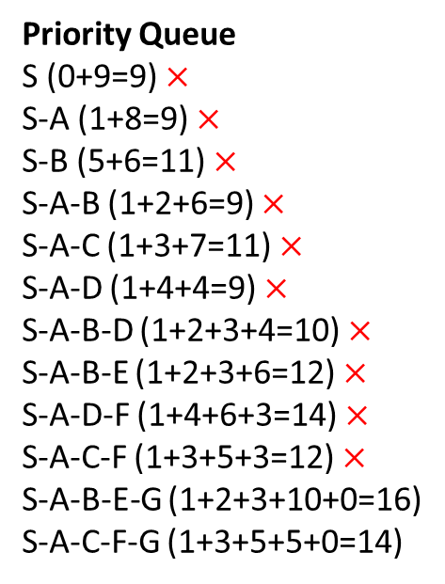
Example (A*)
Expanded Node List
S, A, B, D, C, E, F
S,9
Priority Queue
S (0+9=9) $×$
S-A (1+8=9) $×$
S-B (5+6=11) $×$
S-A-B (1+2+6=9) $×$
S-A-C (1+3+7=11) $×$
S-A-D (1+4+4=9) $×$
S-A-B-D (1+2+3+4=10) $×$
S-A-B-E (1+2+3+6=12) $×$
S-A-D-F (1+4+6+3=14) $×$
S-A-C-F (1+3+5+3=12) $×$
S-A-B-E-G (1+2+3+10+0=16)
S-A-C-F-G (1+3+5+5+0=14)
A,9
B,11
B,9
C,11
D,9
D,10
E,12
F,14
F,12
G,16
G,14

Slide 37
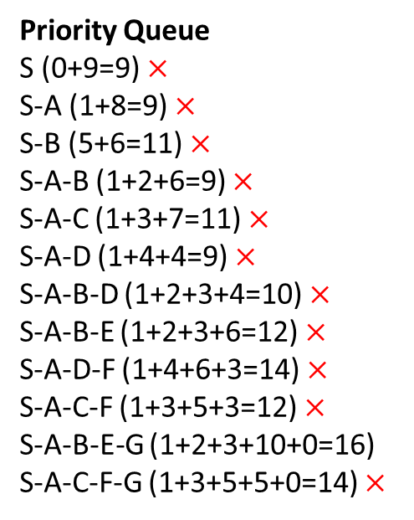
Example (A*)
Expanded Node List
S, A, B, C, D, E
S,9
Priority Queue
S (0+9=9) $×$
S-A (1+8=9) $×$
S-B (5+6=11) $×$
S-A-B (1+2+6=9) $×$
S-A-C (1+3+7=11) $×$
S-A-D (1+4+4=9) $×$
S-A-B-D (1+2+3+4=10) $×$
S-A-B-E (1+2+3+6=12) $×$
S-A-D-F (1+4+6+3=14) $×$
S-A-C-F (1+3+5+3=12) $×$
S-A-B-E-G (1+2+3+10+0=16)
S-A-C-F-G (1+3+5+5+0=14) $×$
A,9
B,11
B,9
C,11
D,9
D,10
E,12
F,14
F,12
G,16
G,14

Slide 38
Example (A*)
Expanded Node List
S, A, B, C, D, E
S,9
Priority Queue
S (0+9=9) $×$
S-A (1+8=9) $×$
S-B (5+6=11) $×$
S-A-B (1+2+6=9) $×$
S-A-C (1+3+7=11) $×$
S-A-D (1+4+4=9) $×$
S-A-B-D (1+2+3+4=10) $×$
S-A-B-E (1+2+3+6=12) $×$
S-A-D-F (1+4+6+3=14) $×$
S-A-C-F (1+3+5+3=12) $×$
S-A-B-E-G (1+2+3+10+0=16)
S-A-C-F-G (1+3+5+5+0=14) $×$
A,9
B,11
B,9
C,11
D,9
D,10
E,12
F,14
F,12
G,16
G,14

Slide 39
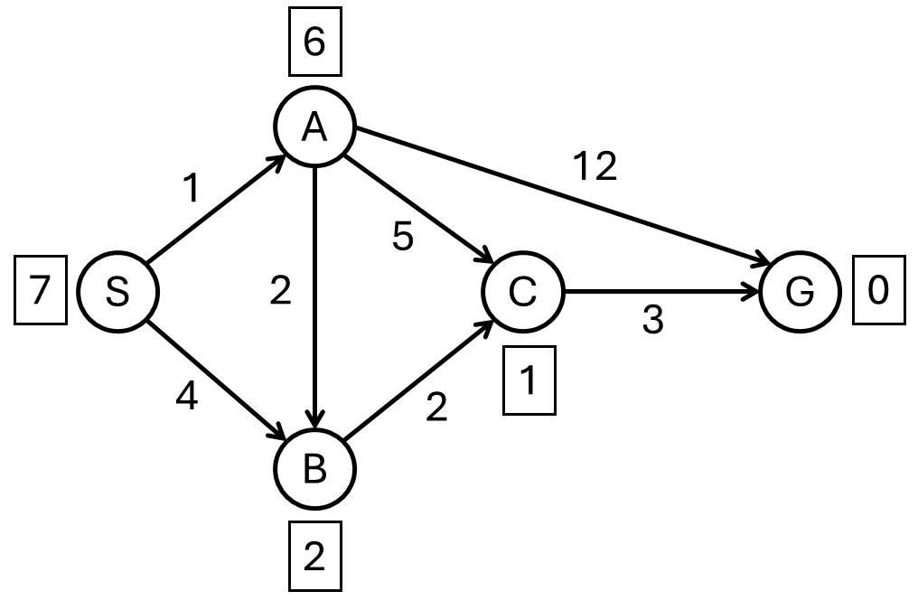
Exercise
Consider S is the starting state, and G is the goal state in the graph. The heuristic value h(n) is given in square boxes and the step costs are given in the edges.
Construct the search tree to find the least cost path from the start state S to the goal state G using UCS, GBFS and A* search for the given graph.
Clearly mention the expand sequence and, path with the path cost.

Slide 40
References
Chapter 3: Solving Problem by Searching , Pages 92-97
“Artificial Intelligence: A Modern Approach,” by Stuart J. Russell and Peter Norvig,

Slide 41
Books
“Artificial Intelligence: A Modern Approach,” by Stuart J. Russell and Peter Norvig.
"Artificial Intelligence: Structures and Strategies for Complex Problem Solving", by George F. Luger, (2002)
"Artificial Intelligence: Theory and Practice", by Thomas Dean.
"AI: A New Synthesis", by Nils J. Nilsson.
“Programming for machine learning,” by J. Ross Quinlan,
“Neural Computing Theory and Practice,” by Philip D. Wasserman, .
“Neural Network Design,” by Martin T. Hagan, Howard B. Demuth, Mark H. Beale, .
“Practical Genetic Algorithms,” by Randy L. Haupt and Sue Ellen Haupt.
“Genetic Algorithms in Search, optimization and Machine learning,” by David E. Goldberg.
"Computational Intelligence: A Logical Approach", by David Poole, Alan Mackworth, and Randy Goebel.
“Introduction to Turbo Prolog”, by Carl Townsend.

